Slide 1
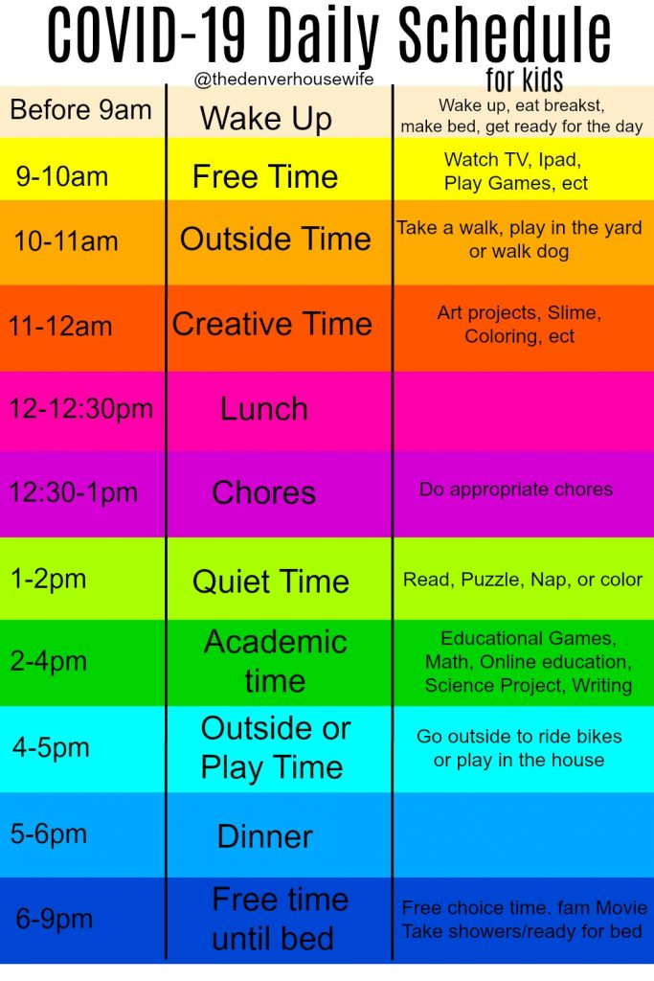
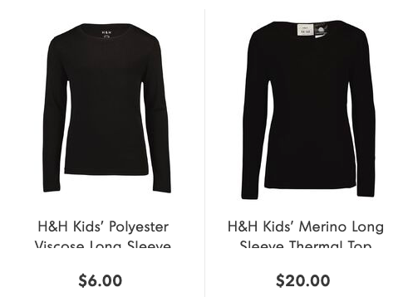
Te Kākano Hub Newsletter
Term 1 ~ Week 7 & 8 ~ 2020
Nau Mai Haere Mai - Welcome
Welcome Ameleah (wk7) & Ming Hao (wk8) - we pray you have happy school days with us and that God blesses you as you transition into school.
COVID-19 Virus - Te Kākano’s Initial Response
You will all be well aware of New Zealand’s response to the spread of coronavirus. We feel it is time to start the conversation with our children about keeping ourselves healthy. Over the week, teachers will be talking about how to wash hands properly, ensuring we cough into our elbows and how to take hold of that amygdala when it starts to tell us we are unsafe, even though at the moment we are fine. We know that giving children the tools to know what to do helps them to keep anxiety levels down which is really important - an anxious brain doesn’t learn.
Here is the link to the washing hands song: https://www.youtube.com/watch?v=S9VjeIWLnEg
The Ministry of Education is updating Liz daily. It is a good idea to come up with a plan if school is closed for an extended period of time. It wouldn’t hurt to have a few ‘maths worksheet’ books and library books for your children. Although worksheet learning isn’t the best, it is better than having bored children stuck inside.
As per usual practice, please keep all sniffles and coughs at home!
This season is all about keeping your children and your family calm. God has not given us a spirit of fear and we aren’t our best selves when we are in a state of panic. Do your best to be prepared (see above schedule as an example of what a day home might look like) and keep God’s promises at the forefront of your mind.
Good to Know
As the days get cooler, it is important that TK children come to school prepared for the weather. Girls are encouraged to wear black tights/stockings under their skorts and boys can wear long black socks. We recommend your child brings a polar fleece to school everyday.
Black long sleeved thermals can also be worn under the uniform too (no other colours permitted).
→See these examples from The Warehouse→
Sunhats are still compulsory for Term 1 & 4, however it is okay to put a black beanie in your child’s bag too.

Slide 2
Learning Through Play - Seesaw
By now you will have seen posts come through on your Seesaw app about what is happening with your child’s character development in Learning Through Play. Seesaw is a fantastic tool for teachers to use to quickly communicate. The teachers are currently assessing the learning against the RC Values Competencies Rubrics. We are in the process of seeing how this information can be communicated to you, as currently Seesaw hasn’t allowed this. However, you will be able to see what area your child is working on via the ‘tag’ that comes up. These tags are ‘Christ-like, Creative, Critical Thinkers, Hope, Excellence, Love or Peace’.
It’s a good idea to think about how your child is going at home. Are you noticing that they are maturing? What areas do you think they have made progress in over the past few weeks? Celebrate this growth with them! It’s really important in shaping children that they know the adults around them are proud of them.
Reminders
Hats must be worn everyday. Please name this clearly or ask your child’s Kōhanga teacher to use their silver pen to name it.
This is the best time of year to make sure EVERYTHING that your child brings to school has their NAME on it.
Children need sunscreen on daily please.
Teachers are available for quick ‘transition’ chats before school, please save longer chats for after school or make an appointment.
Correct uniform must be worn every day.
Toys are not be be brought to school.
Up-and-Coming Events
Week 7 Every Wk 5 & Wk 7 of the Term, TK teachers will be taking their Classroom Release Time (CRT) | Tues 16 Mar Wed 17 Mar Thur 18 Mar Fri 19 Mar | Mrs Nuthall’s CRT: Mrs Gaye Woodlock will be taking Rarahu Leadership Day: Miss Horn, Miss Liggett, Mr Marshall, Mrs Cleave and Mrs Siave will be working in the TK office and won’t be available that day. Miss Langridge’s CRT: Mrs Madeleine Cunningham will be in Mānuka Mr Smith’s CRT: Mrs Rowena G will be in Kōwhai TK Assembly: Check to Seesaw to see if your child is receiving a certificate. Forest LTP & Friday Rotations: Be prepared for outdoor fun in school PE gear
Week 8 | Wed 25 Mar Thurs 26 Mar Fri 27 Mar | Miss Liggett away at Coaching Course: Mr Andrew Deadmarsh is in for her. TK Assembly: Check your seesaw message area to see if your child is receiving a certificate. Outdoor LTP: Dress for the weather! Cheese Roll Forms Due today!
Weekly | Monday & Tuesday | Meetings: Please be aware TK teachers have meetings after school on these days, so please pick your children up promptly so we can get ready for these.
Blessings,
Miss Emily Langridge (Mānuka), Mr Mark Smith (Kōwhai), Mrs Gabby Nuthall (Rarahu) & Miss Kendra Liggett (Koru)

